Slide 1

Jupyter Notebook

Slide 2
Objectives
Describe the fundamentals of Jupyter Notebooks and the JupyterLab platform and why they are popular for data science projects.
Cite some examples of how Jupyter is used in data science for recording experiments and projects.
Use Jupyter notebooks to experiment with code cells, create data visualization slides, and reporting results using Markdown.
Create a Jupyter notebook with Python and use it to run code, change kernels, and save your work.
Jupyter Notebook

Slide 3
What is s Jupyter Notebook
Jupyter Notebook is a tool for recording data science experiments
Jupyter stands for:
  Julia
  Python
  R
Its allows a data scientist to combine text and code block in a single file
It generates plots and tables within the file
Notebooks can be exported as pdf, html files
Jupyter Notebook

Slide 4
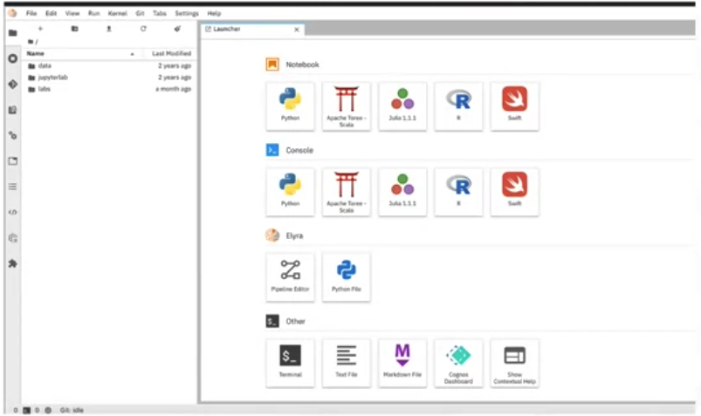

Introduction to Jupyter Lab
It is an interactive environment for Jupyter Notebook
It allows for real time editing
It is compatible with several file formats
An it is open source
Jupyter Notebook

Slide 5
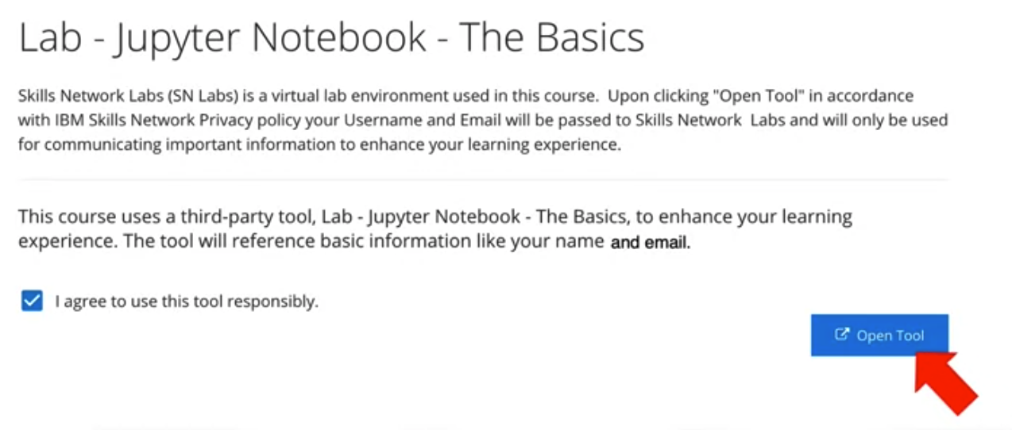
Starting the Notebook
Jupyter Notebook

Slide 6
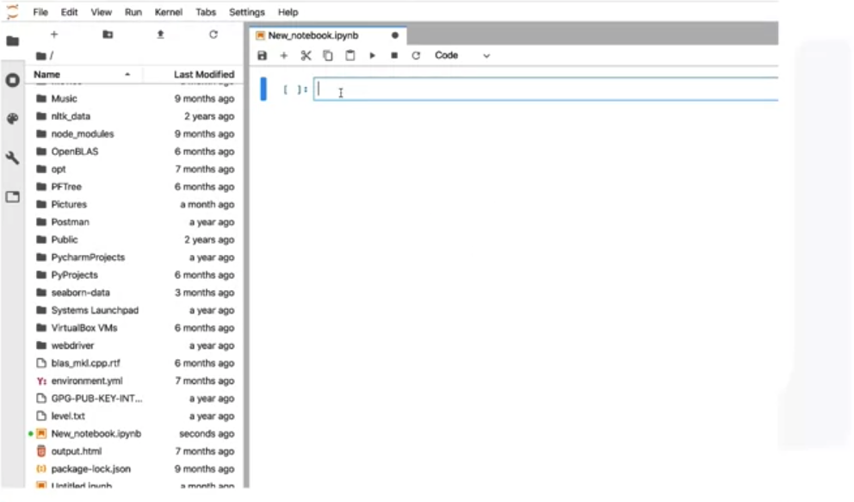
Opening the Notebook
Jupyter Notebook

Slide 7
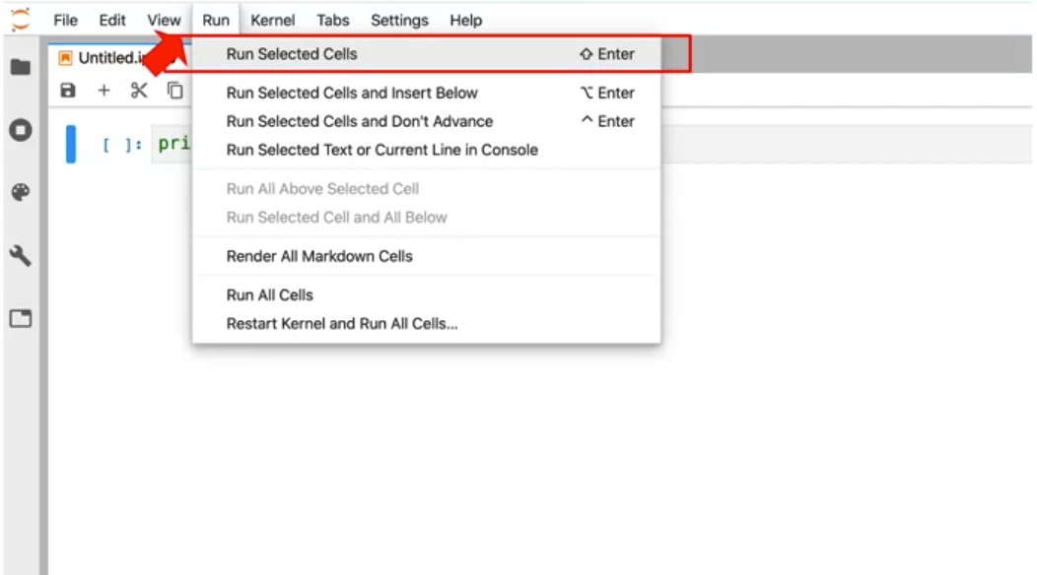
Run a cell in a Notebook
Jupyter Notebook

Slide 8
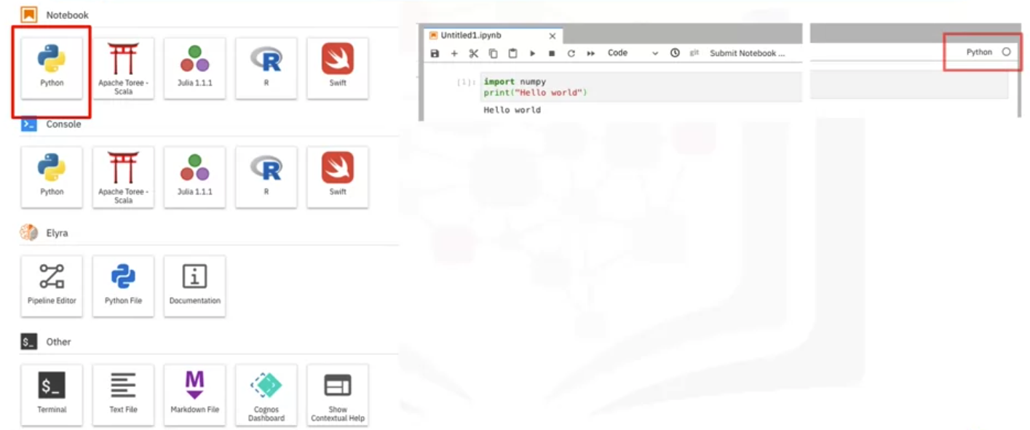
Kernel of Jupyter Notebook
A notebook kernel is a computational engine that executes the code contained in the notebook file
Jupyter Kernel for many other languages exist
When the notebook is executed, the kernel perform the computation and produces the results
Python kernel:
Jupyter Notebook

Slide 9
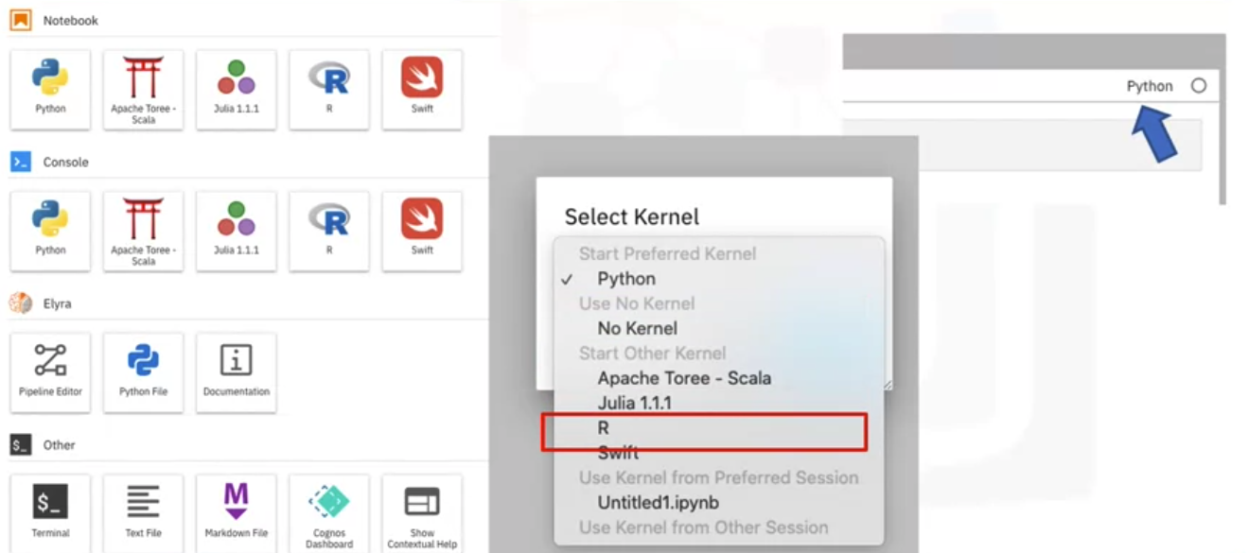
Kernel of Jupyter Notebook
You can change the kernel by following way
Jupyter Notebook

Slide 10
Jupyter Architecture
Jupyter implements a two-process model, with a kernel and a client
The client is the interface offering the user the ability to send code to the kernel
The kernel executes the code and returns the result to the client for display
The client is the browser when using a jupyter notebook
Jupyter notebook =s us used to present code, metadate, contents and outputs
It has a flexible interface that extends beyond code and output
Jupyter Notebook

Slide 11
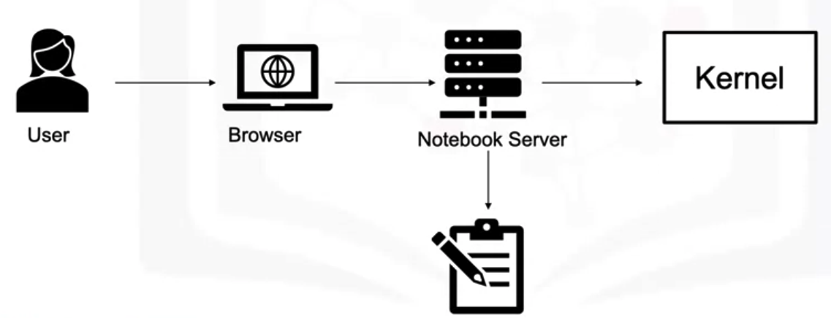
Jupyter Architecture
When the user, saves it, it is sent from your browser to the Notebook server which saves the notebook file on a disk as a JSON file with a dot I PI NB (.ipynb) extension.
The Notebook server is responsible for saving and loading the notebooks.
The kernel gets sent the cells of code when the user runs them.
Jupyter also has an architecture of how it converts files to other formats.
Jupyter Notebook

Slide 12
Summary
Describe the fundamentals of Jupyter Notebooks and the JupyterLab platform and why they are popular for data science projects.
Cite some examples of how Jupyter is used in data science for recording experiments and projects.
Use Jupyter notebooks to experiment with code cells, create data visualization slides, and reporting results using Markdown.
Create a Jupyter notebook with Python and use it to run code, change kernels, and save your work.
Jupyter Notebook

Slide 13
Q & A
Jupyter Notebook

